Slide 1

Project on Simulation Of Differential Relay Protection And Numerical Relay Protection On Virtual Power Lab
Under Guidance of:- Presented By:-
Prof. D.K. CHATURVEDI RAJIT KUMAR
SAKSHAM PATHAK
SUNIL CHHALOTRA
YOGESH KUMAR

Slide 2
INTRODUCTION
Virtual lab and its goal.
Relay protection system
Differential Relay Protection.
Numerical Relay Protection.
Simulation of protection system.
References.

Slide 3
What is virtual lab and its goal
Virtual Labs is a project initiated by the Ministry of Human Resource and Development, Government of India, under the National Mission on Education through Information and Communication Technology.
It also intends to develop a complete Learning Management System where the students can avail the various tools for learning, including additional web-resources, video-lectures, animated demonstrations and self-evaluation.

Slide 4
GOALS OF VIRTUAL LAB
To provide remote-access to Laboratories in various disciplines like Engineering and Science.
To develop a complete Learning Management System.
To work for their own convenience and easily understand the practical concepts to students.
To provide safety against serious shocks.

Slide 5
RELAY PROTECTION SYSTEM
There is two types of Protection Relays, Which have been simulated on virtual lab:
Differential Relay Protection of Transformer.
Numerical Relay Protection of Induction Motor.

Slide 6
Differential Relay Protection of Transformer
As the CTs are placed on terminals of primary and secondary windings of Transformer, according to their corresponding turn ratio.
In this protection system only protected zone (part in between the primary CT and secondary CT) should be protected.
CTs turn ratio are selected such that the same amount of current flows through the primary and secondary CTs under normal operating condition.

Slide 7
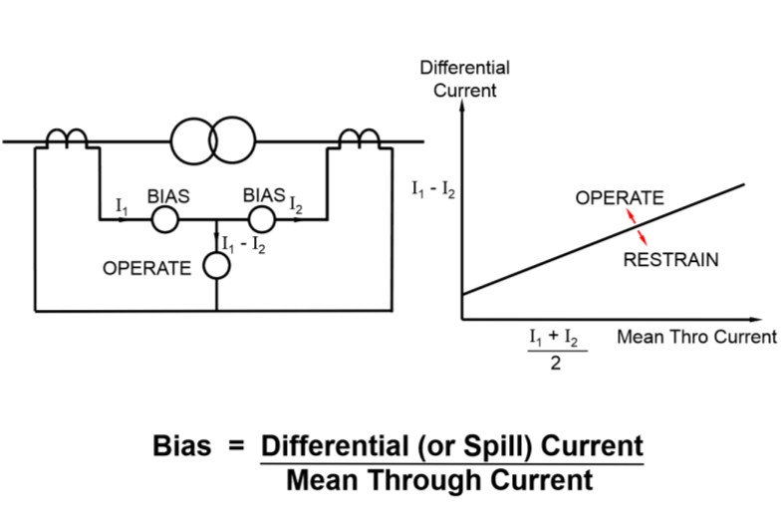
Differential relays work is that to calculate the difference between the primary and secondary CTs current.

Slide 8
Under normal operating condition i.e. no faults in protected zone, Thus the differential current is :
I_{d} = I₁-I₂ = 0 (Zero)
When fault is occurs in protected zone, then differential current is:
I_{d} = I₁-I₂ ≠ 0 (Zero)

Slide 9
Numerical Relay Protection of Induction Motor.
A numerical relay is a solid state relay also called static relay. It contains electronic circuitry which may include transistors, ICs, diode and other electronic components. There is a comparator circuit in it, which comparing 2 or more voltages or currents gives output applied to either a slave relay or a thyristor circuit.

Slide 10
The numerical relay has been designed to protect the motor against as mechanical overload, stalling and locked rotor, short circuit, earth fault , phase unbalancing, single phasing, terminal box and cabling failures, and too frequent starts.
The slave relay is an electromagnetic, semi static relay which closes its contacts.

Slide 11
ADVANTAGES OF NUMERICAL REALAYS
Low burden on CT and PT.
fast operation.
absence of mechanical inertia and contact trouble.
long life and less maintenance.
So, they are superior to electromagnetic relay, but they are costly and required more maintenance.

Slide 12
Simulation of protection system.
In this part of project, work is that to create either animated pictures or controlling the images of different protection systems of Transformer and Induction Motor.
This is much more helpful for understanding about protection system and different types of faults.

Slide 13
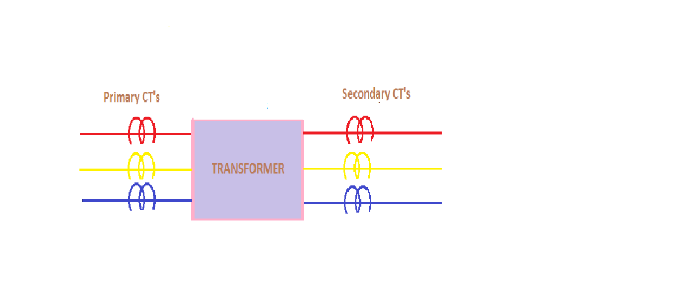
IMAGES FOR SIMULATION OF DIFFERENTIAL RELAY PROTECTION OF TRANSFORMER
INITIAL STAGE i.e. No connection of Transformer selected

Slide 14
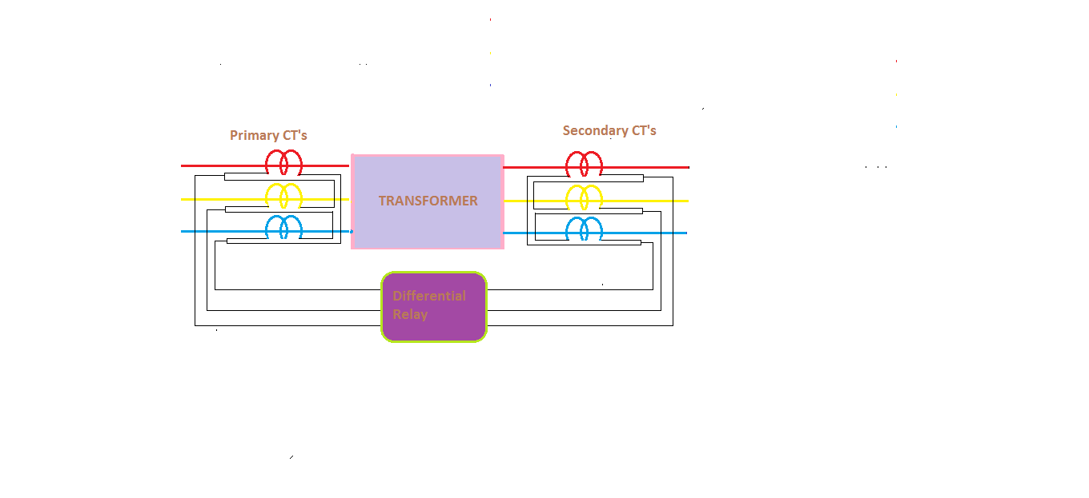
When Transformer connection is STAR-STAR
Then the CTs connections are DELTA-DELTA.

Slide 15
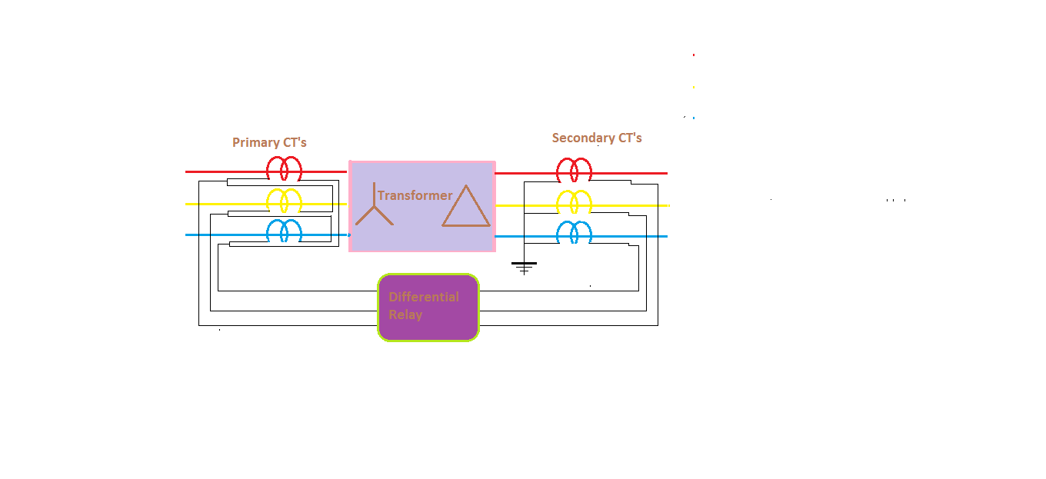
When Transformer connection is STAR-DELTA
Then the CTs connections are DELTA-STAR.

Slide 16
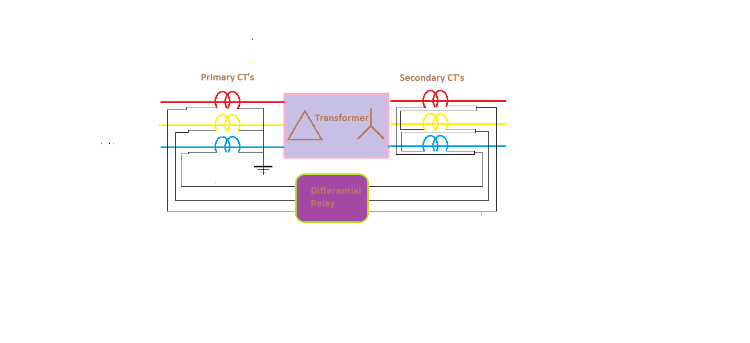
When Transformer connection is DELTA-STAR.
Then the CTs connections are STAR-DELTA.

Slide 17
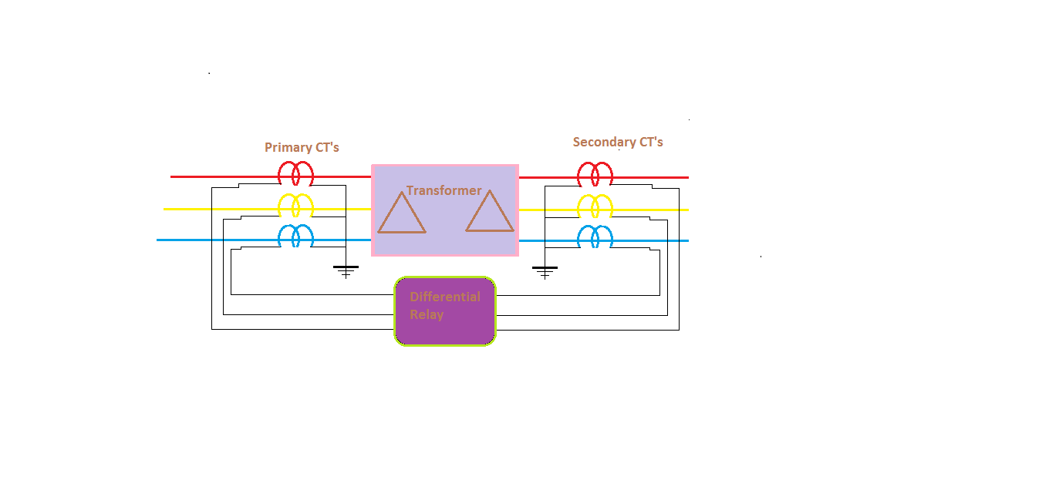
When Transformer connection is DELTA-DELTA.
Then the CTs connections are STAR-STAR.

Slide 18
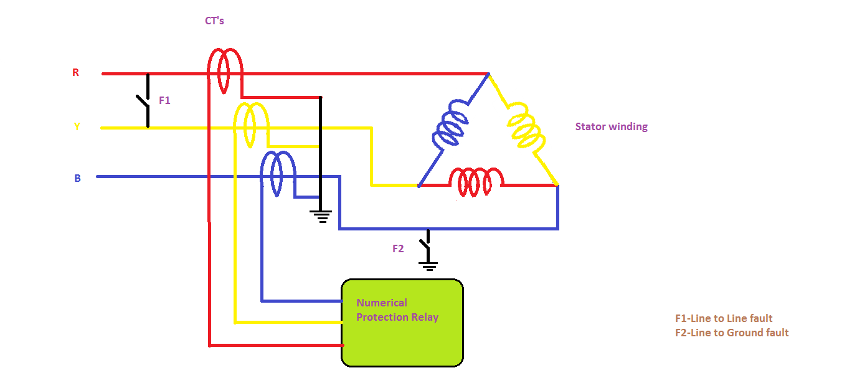
IMAGES FOR SIMULATION OF NUMERICAL RELAY PROTECTION OF INDUCTION MOTAR
When no fault occurs i.e. normal operating condition.

Slide 19
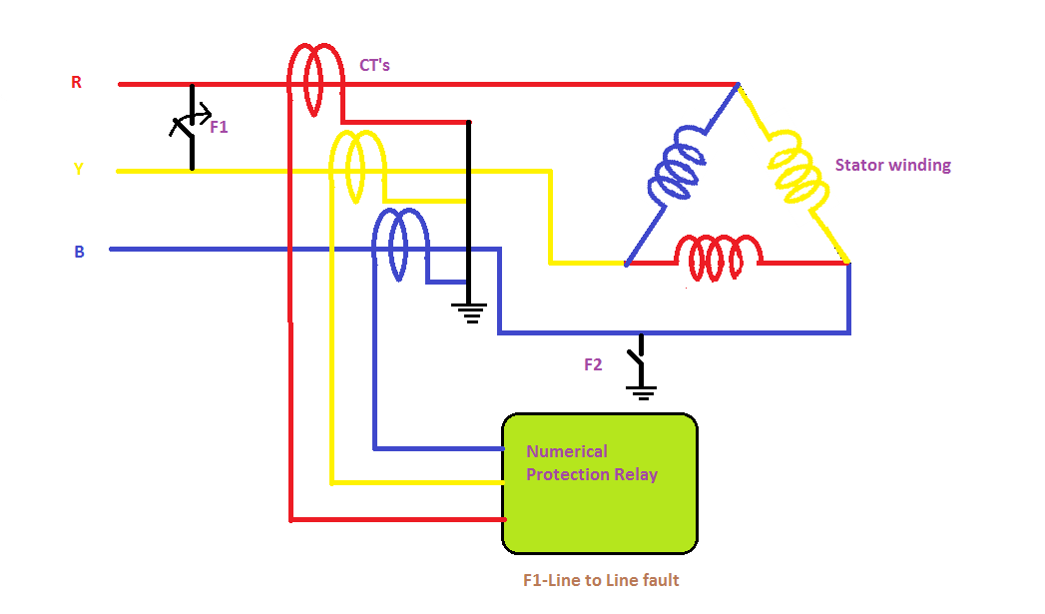
When fault F1 (Line to Line) occurs

Slide 20
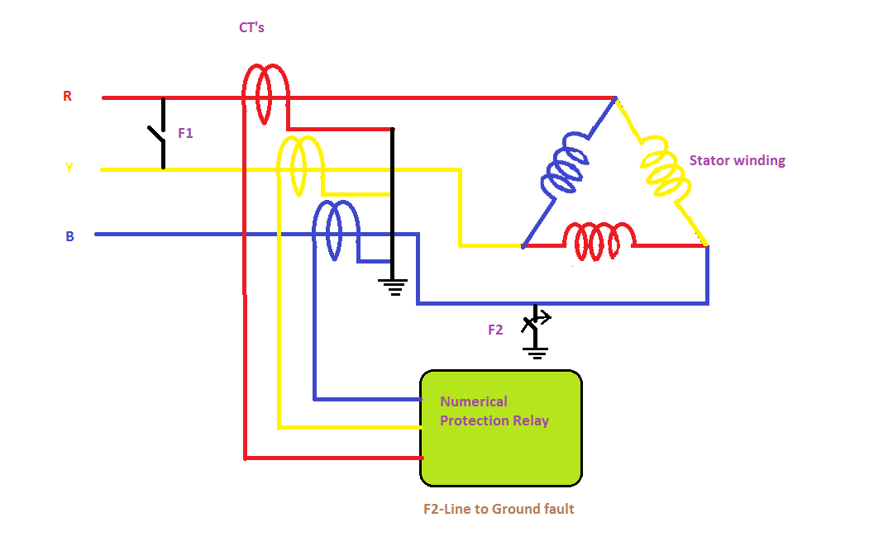
When fault F2 (Line to Ground) occurs

Slide 21
REFERENCES
D.E.I. Virtual website : www.vlab.dei. co.in
Wikipedia.
Power systems by C.L.Wadhwa.

Slide 22
THANK YOU

